Slide 1

IS HIGHER EDUCATION LEARNING ANYTHING?
The Dangers to U.S. Institutions of Higher Education from the Disruptive Challenges in the 21st Century?
Mike E. O’Neal, JD, CPA, President Emeritus
Oklahoma Christian University
AIRA Conference
Denver, CO
June 5, 2014

Slide 2
Is Higher Education Learning Anything?
AIRA – June 5, 2014
RECENT HEADLINES
Bryan College, Facing Enrollment Drop, Cuts Positions
Moody's Downgrades Laureate's Credit Outlook
Business School, Disrupted
College Credentials by Condé Nast
13 Reasons Colleges Are in This Mess*
Moody’s Warns of ‘Sharp Deterioration’ in College Finances
More than 100 Colleges Fail Education Department’s Test of Financial Strength
Time to Close the College?

Slide 3
Is Higher Education Learning Anything?
AIRA – June 5, 2014
RECENT HEADLINES cont’d
The Ivory Tower: Crumbling from Within?
Bursting the Higher Ed Bubble
Led By For-Profit Colleges, Student Loan Defaults At Highest Level In A Decade
Will Higher Education Be the Next Bubble to Burst?
Is a College Diploma Worth the Soaring Student Debt?
46 Percent Of Federal Loans Paid To For-Profit Institutions Will Go Into Default
Private Student Loan Bankruptcy Bill... The 4th Attempt

Slide 4
Is Higher Education Learning Anything?
AIRA – June 5, 2014
SUMMATION OF ARTICLES
“The environment in which higher
education operates today and the rules of
engagement are changing rapidly and
drastically, and those who fail to prepare
and adapt are doomed to decline or
failure.”

Slide 5
Is Higher Education Learning Anything?
AIRA – June 5, 2014
The higher ed revolution is coming. Just a few decades hence, half the colleges and universities in the United States will have disappeared, but schools like Harvard will have millions of students.
-- Nathan Harden, “The End of the University as We Know It” in The American Interest 12/11/12

Slide 6
Is Higher Education Learning Anything?
AIRA – June 5, 2014
“In 15 years from now half of US universities may be in bankruptcy. … in the end I’m excited to see that happen. So pray for Harvard Business School if you wouldn’t mind.”
-- Clayton Christensen, HBS, co-author of Disrupting Class: How Disruptive Innovation Will Change the Way the World Learns McGraw-Hill, 2008.

Slide 7
Is Higher Education Learning Anything?
AIRA – June 5, 2014

Slide 8
Is Higher Education Learning Anything?
AIRA – June 5, 2014
Recent History & Current Status
Higher Education Sector
Perception of Perseverance – Bologna 1088
Prevailing Model – Ivory Tower
Tuition and Fees –
Cost Pressures -
Social Stature – Perceived Value
Denial of Reality
Rise of For-Profit Institutions

Slide 9
Is Higher Education Learning Anything?
AIRA – June 5, 2014
SIZE OF HIGHER EDUCATION SECTOR
Number of Degree-Granting Institutions in US:
1980 2011 % Increase
2-Year 1274 1729 36%
4-Year 1957 2870 47%
Total 3231 4599 42%
Number of Students Served: (1,000's)
2-Year 4525 8514 88%
4-Year 7522 15242 103%
Total 12047 23756 97%
Per NCES; US Dept. of Education

Slide 10
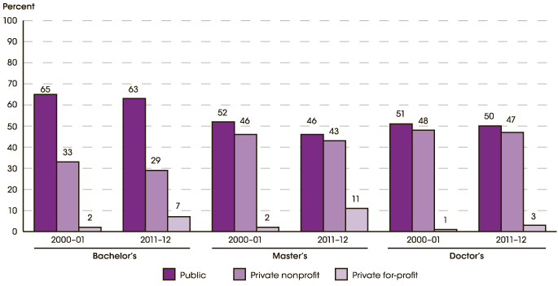
Is Higher Education Learning Anything?
AIRA – June 5, 2014
Percentage of Degrees by Institution Type
2000-01 and 2011-12

Slide 11
Is Higher Education Learning Anything?
AIRA – June 5, 2014
PREVAILING MODEL
*High tuition; high discounting
Expensive instruction; faculty loads; class sizes
Residential life; massive investment in campuses
Limited flexibility or scalability; calendar; one-size
International Students – 820,000
Mission Creep
Leadership; steward vs. change agent
Shared Governance; molasses movement
High marginal cost
Ivory Tower

Slide 12
Is Higher Education Learning Anything?
AIRA – June 5, 2014
Average Tuition, Fees, Room & Board (4-Yr Inst’ns):
FY82 FY12 % Increase
Public $6,942 $16,789 142%
Private $15,306 $33,716 120%
Current Discount Rate = 42.4%
NCES, Dept. of Ed. **2011-12 Constant Dollars**

Slide 13
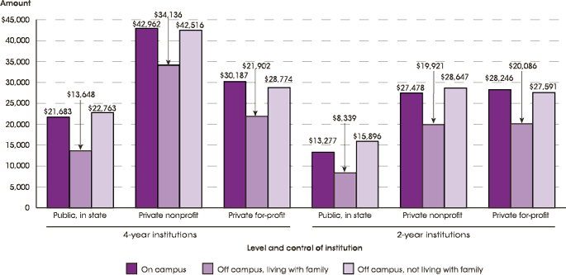
Is Higher Education Learning Anything?
AIRA – June 5, 2014
Average Net Cost of Attendance
2012-2013

Slide 14
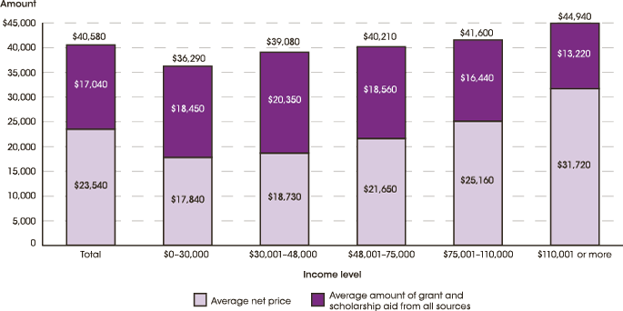
Is Higher Education Learning Anything?
AIRA – June 5, 2014
Average Net Price and Assistance
Private Non-Profit 4-Year Institutions
2011-2012

Slide 15
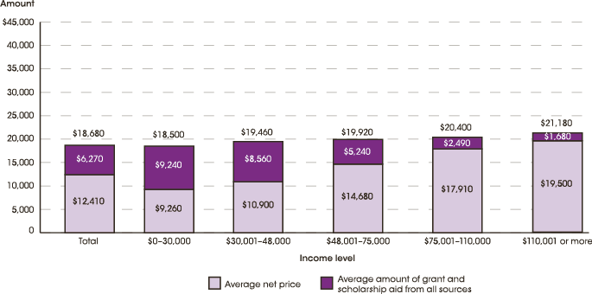
Is Higher Education Learning Anything?
AIRA – June 5, 2014
Average Net Price and Assistance
Public 4-Year Institutions
2011-2012

Slide 16
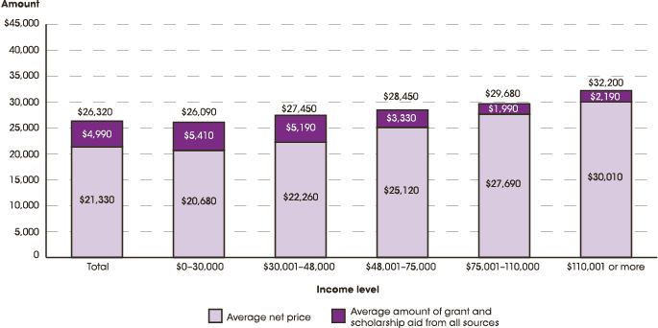
Is Higher Education Learning Anything
AIRA – June 5, 2014
Average Net Price and Assistance
Private For-Profit 4-Year Institutions
2011-12

Slide 17
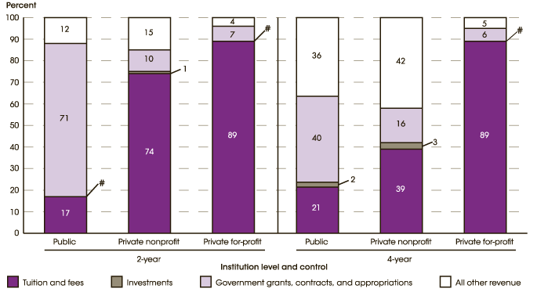
Is Higher Education Learning Anything?
AIRA – June 5, 2014
Percentage of Total Revenue
2012-2013

Slide 18
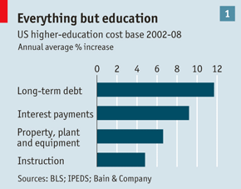
Is Higher Education Learning Anything?
AIRA – June 5, 2014

Slide 19
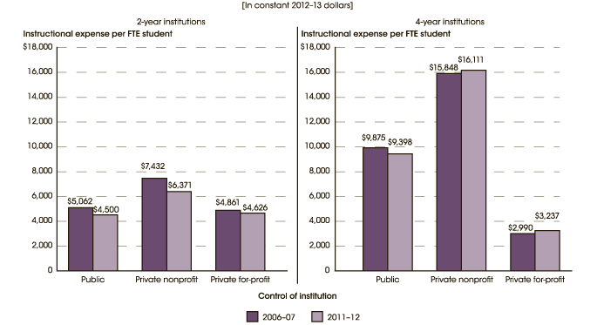
Is Higher Education Learning Anything?
AIRA – June 5, 2014
Instructional Expense per FTE Student
2006-07 and 2011-12

Slide 20

Is Higher Education Learning Anything?
AIRA – June 5, 2014

Slide 21

Is Higher Education Learning Anything?
AIRA – June 5, 2014

Slide 22
Is Higher Education Learning Anything?
AIRA – June 5, 2014
RISE OF FOR-PROFIT INSTITUTIONS
2000-2012 – CAGR OF 16% (-7% in 2011-12)
11% of H.E. market in 2011-12; 65% mkt. over age 25
$29.6 B revenue in 2010
80% of revenue from federal aid programs; 47% of defaults
88 merger transactions ($12.5 B) since 1999
Largest 14 average market cap of $776.5 MM; Apollo, DeVry, Grand Canyon approaching $2 B each

Slide 23
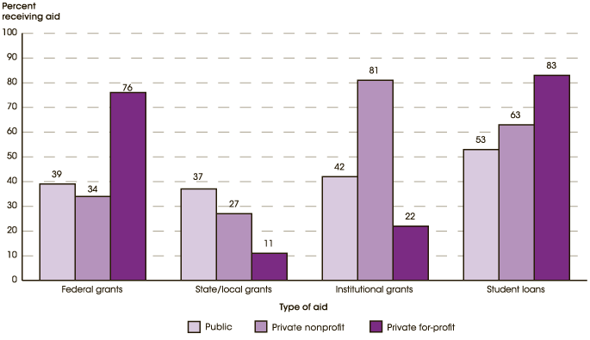
Is Higher Education Learning Anything?
AIRA – June 5, 2014
Type of Assistance by Type of Institution
2011-2012

Slide 24
Is Higher Education Learning Anything?
AIRA – June 5, 2014
DISRUPTIVE FORCES OUTSIDE THE ACADEMY
Demographics-Traditional students
Competition-For Profits/Int’l/Non-Profit/Recruiting
Cultural Shifts-Attn. Span/Redefine Education
Technology:
  Online
  Classroom uses
  MOOCs: edX – Harvard/MIT; Coursera – Stanford/Penn/Michigan/Berkeley/Princeton; Udacity; West. Governors
  Credentialing
Skewing of Common Sense Economics – Bubble

Slide 25
Is Higher Education Learning Anything?
AIRA – June 5, 2014
Skewing of Common Sense Economics
Government Changed Funding Paradigm
H.E. = 3.1% of economy; 2.1% funded by taxes
2005 Bankruptcy Abuse Prevention and Consumer Protection Act
Student Debt Bomb:
  $23,000/student; many over $100,000
  $1 Trillion; 2nd largest private credit in US
Compare H.E. Bubble to Housing Bubble

Slide 26
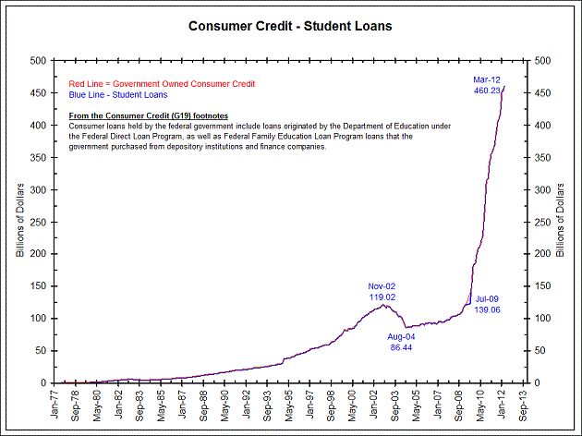
Is Higher Education Learning Anything?
AIRA – June 5, 2014
STUDENT LOANS HELD BY FEDERAL GOVERNMENT

Slide 27
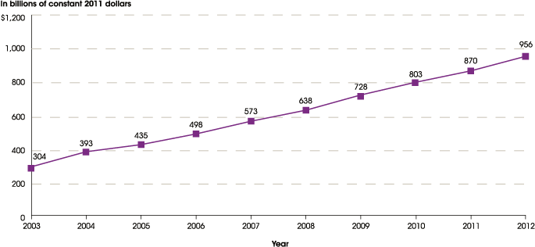
Is Higher Education Learning Anything?
AIRA – June 5, 2014
Total Student Loan Debt
2003-2012

Slide 28

Is Higher Education Learning Anything?
AIRA – June 5, 2014

Slide 29
Is Higher Education Learning Anything?
AIRA – June 5, 2014
OTHER DISRUPTIVE EXTERNAL FORCES
Declining State Government Support
Politically Correct Assertion that H.E. is for All
Stratification of Higher Ed – Haves and Have-Nots
Accreditation Based on Learning and Competency Assessment
Occupational Training Emphasis
Declining Investment Returns
Increasing Government Regulations
Commercialized vs. Fundamental Research
Market Demand for Flexibility/Unbundling
Rating Agency Downgrades

Slide 30
Is Higher Education Learning Anything?
AIRA – June 5, 2014
Positive Forces Impacting Higher Education
Tradition
Inertia
Upward Mobility – still true
International Students Increasing – short-term
Brand loyalty of alumni/benefactors
Devotion of Faculty and Staff
Wakening need for values/character/critical thinking
Continuing Shift to Knowledge Society
Positive Adaptation of Technology
Leadership’s ‘Great Awakening’
Education Pays

Slide 31
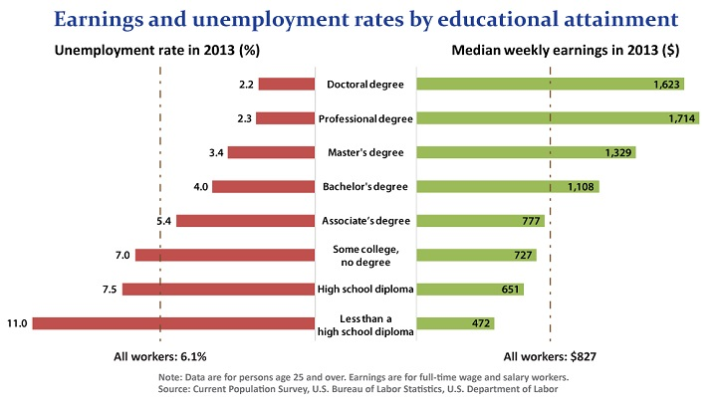
Is Higher Education Learning Anything?
AIRA – June 5, 2014

Slide 32
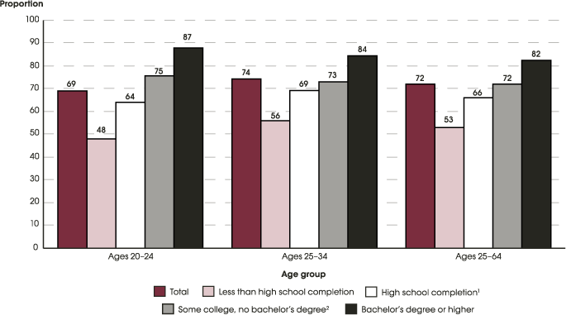
Is Higher Education Learning Anything?
AIRA – June 5, 2014
Employment by Age and Education Attainment
2012

Slide 33

Is Higher Education Learning Anything?
AIRA – June 5, 2014

Slide 34
Is Higher Education Learning Anything?
AIRA – June 5, 2014
Four Ways People Respond to Change
Struggle to cope with change (victim mentality)
Merely comply with change (adjustment mindset)
Capitalize on change (opportunity mindset)
Purposefully create change (possibilities mindset)

Slide 35
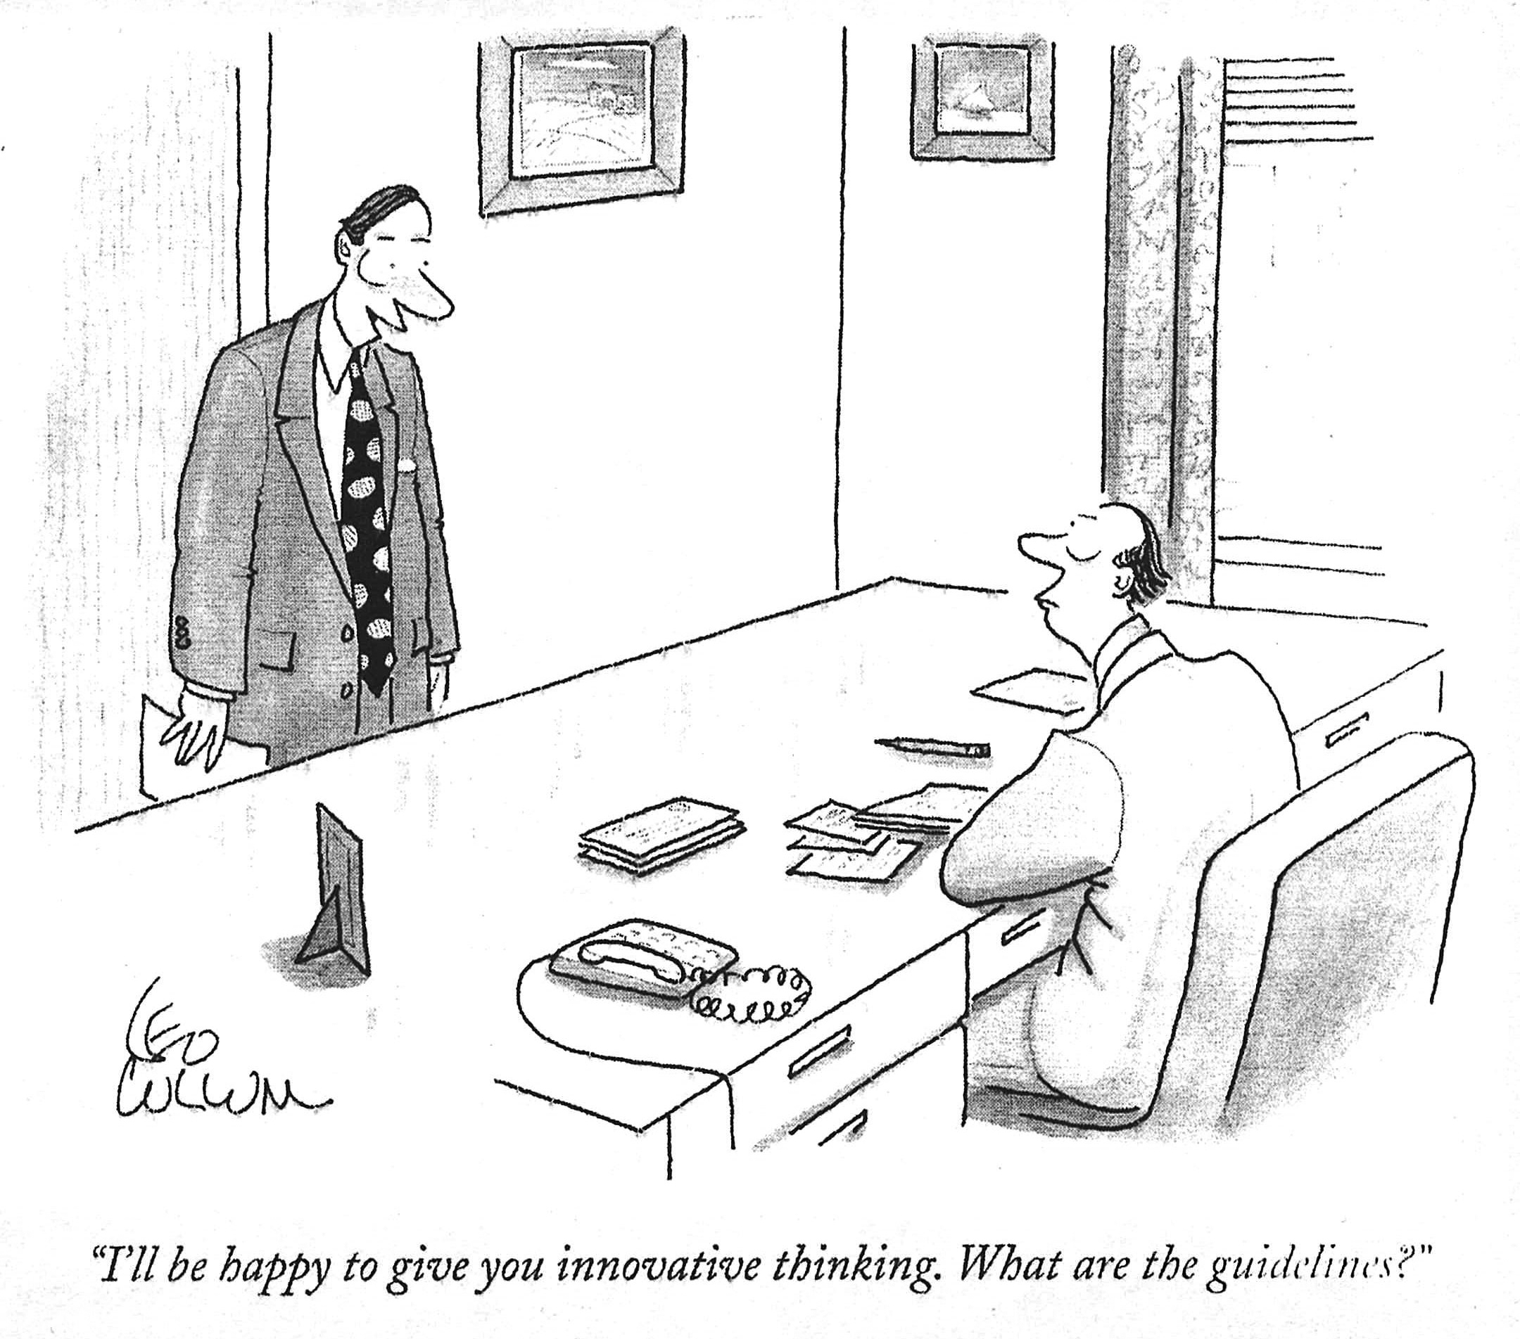
Is Higher Education Learning Anything?
AIRA – June 5, 2014

Slide 36
Is Higher Education Learning Anything?
AIRA – June 5, 2014
  Recognize that resisting the external forces is useless
  Identify which forces are benign, positive, negative, or both
  Strengthen the Balance Sheet
  Business Model Must Change
  Unbundling
  Mergers
  Tenure Must Evolve to Allow Flexibility
  Differentiate; Demonstrate Value

Slide 37
Is Higher Education Learning Anything?
AIRA – June 5, 2014
Q & A

